Slide 1
Principle of protein folding in the cellular environment
The ability of newly synthesized protein chains to fold into their functional form within the complex intracellular environment.

Slide 2
Molecular Chaperons
Proteins that help the folding of other proteins, usually through cycles of binding and release, without forming part of their final native structure.
Increase in the efficiency, not the specificity, of protein folding
Change in emphasis from post-translational modification to co-translational modification
In vitro, both GroEL and Hsp70 interact promiscuously with most unfolded proteins.

Slide 3
Protein folding in the cytosol of prokaryotic and eukaryotic cells.

Slide 4
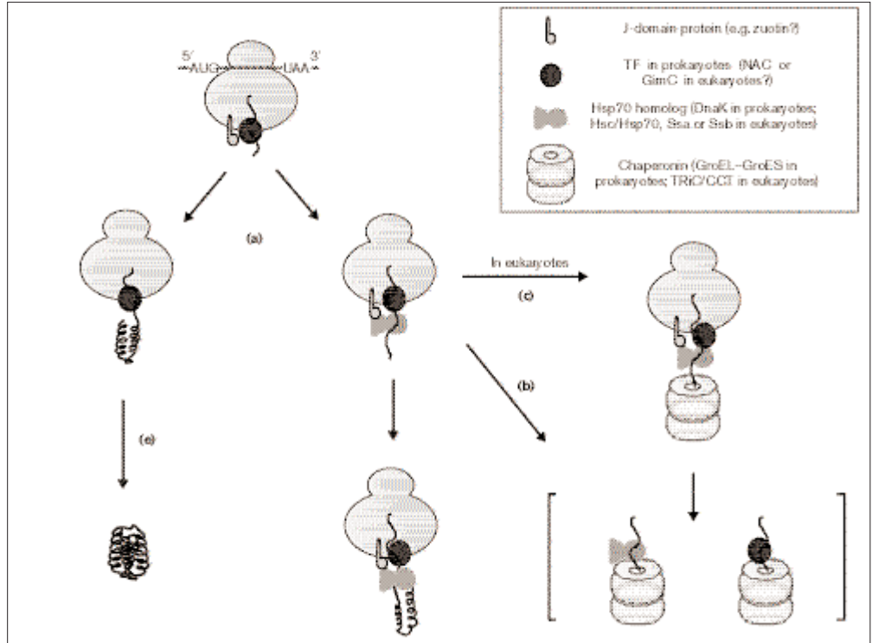
TF: Trigger Factor
NAC: nascent-chain associated complex

Slide 6
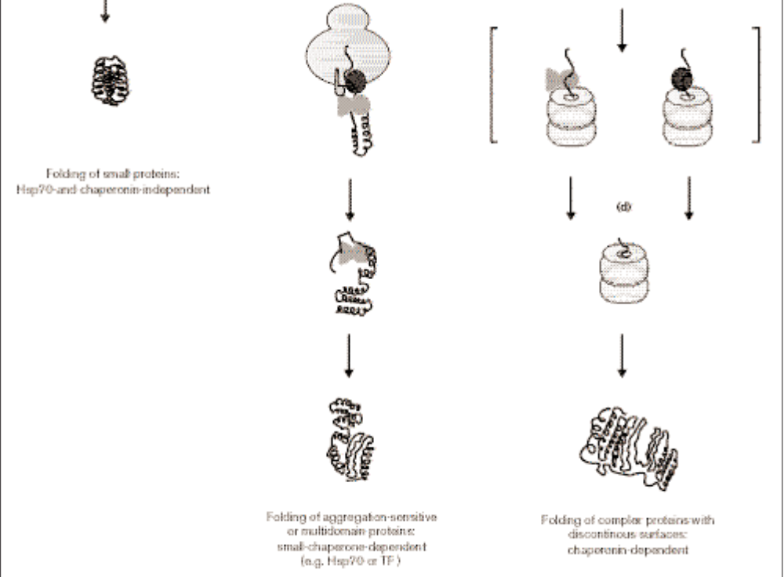
Folding of small protein Hsp 70 and chaperonin independent
Folding of aggregation sensitive or multidomain small chaperon dependent (e.g. Hsp 70 or TF
Folding of complex proteins with discontinuous surfaces: chaperons dependent

Slide 7
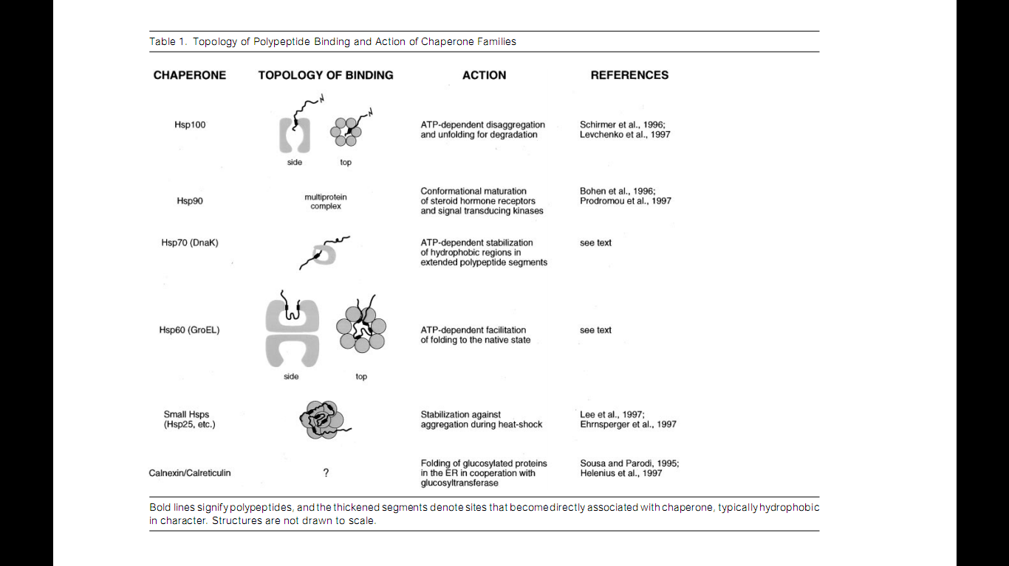

Slide 8
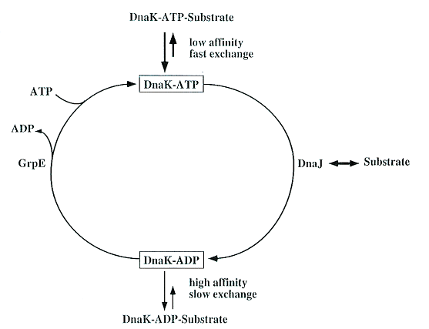
ATPase Cycle and Atomic Structure of the ATPase Domain of Hsp70 Proteins

Slide 9
A chaperonin called GroEL-GroES complex (from Escherichia coli)
Two rings of 7x2GroEL proteins (shown in blue and green) with a cap (just on one side) of GroES proteins (red and yellow)

Slide 10
Pathways of chaperone-mediated protein folding in the cytosol
Nascent polypeptide chains are met by trigger factor (TF) as they emerge from the ribosome. The 70-kDa heat-shock protein DnaK, which is stimulated by its J-domain co-chaperone DnaJ, also binds nascent polypeptides. Newly synthesized polypeptides can fold spontaneously or can be assisted by DnaK. Alternatively, they can be passed to the GroEL–GroES chaperonin system for final folding, and, in some cases, might again interact with DnaK.

Slide 11
The steric information necessary for newly synthesized protein chains to fold correctly within cells resides solely in the primary structure of the initial translation product.
Three families of molecular chaperone best known to interact with newly synthesized protein: hsp70, hsp40, and chaperonins

Slide 12
Reference

